Slide 1
Only 33 Months to Go:
The Battle Against Time
By Steve Milloy
16th International Conference on Climate Change
Panel: The Most Important Upcoming Battles
April 8, 2026

Slide 2
1. Overturn Massachusetts v. EPA
Too much time already wasted rescinding the endangerment finding
  Should have been rescinded last April on legal grounds
  Asking the public for comment on a legal matter was unnecessary
  Greens would have been compelled to sue on validity of Massachusetts v. EPA
Green litigation strategy:
  Run out the clock on Trump
  Drag out the litigation
  Hope for regime change in 2027 and 2029 – future is chaotic and unknowable
  Make sure SCOTUS never has a chance to overturn Massachusetts v. EPA
Upholding the rescission but not overturning Massachusetts v. EPA is a fail

Slide 3
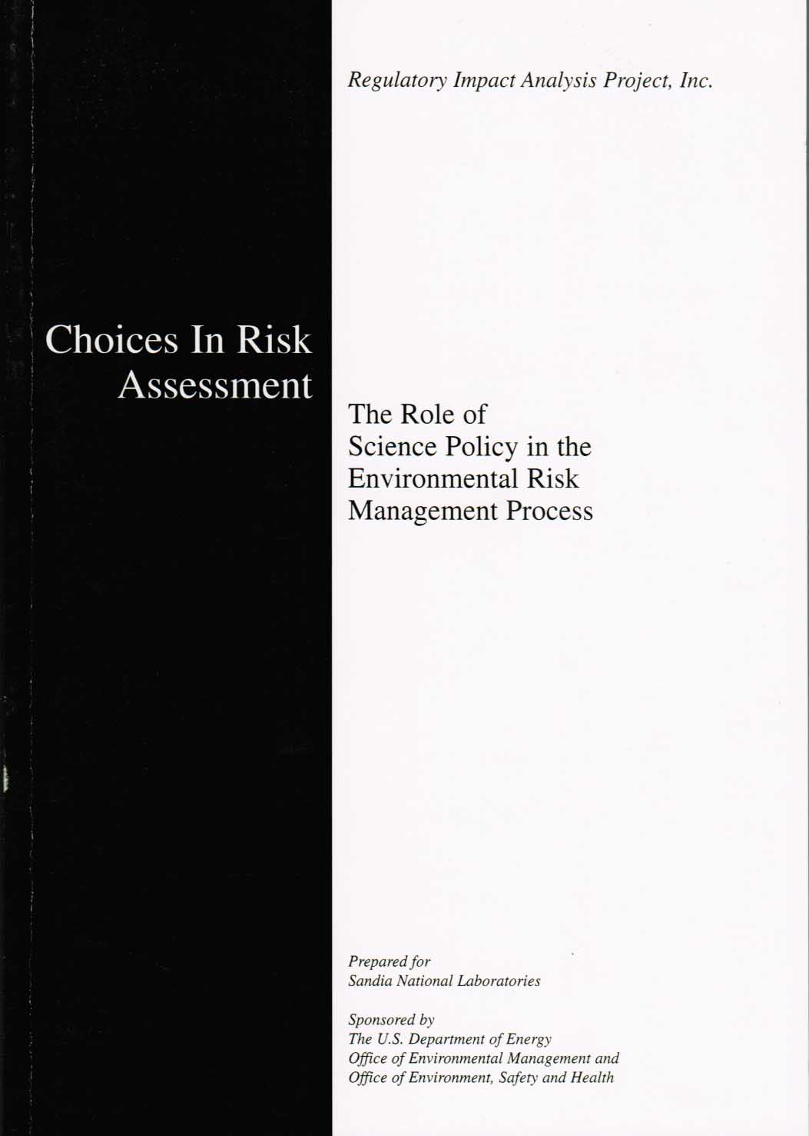
2. Fix EPA Science – Science Policy
Good news: No science to fix
  EPA ≠ Science group
  EPA = Risk Management
Bad news: Precautionary Principle policy masquerading as science
Easy solution is disclosure of uncertainties

Slide 4
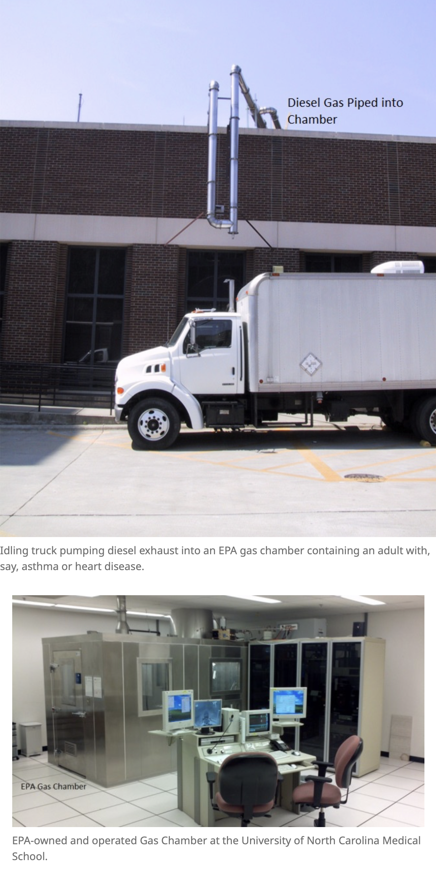
Fix EPA Science – End the Fraud
EPA invented PM2.5 to be its most potent regulatory weapon
Most toxic substance, EPA
Based on junk epidemiology
Human experiments attempted to validate the epidemiology
No luck
Regulate anyway

Slide 5
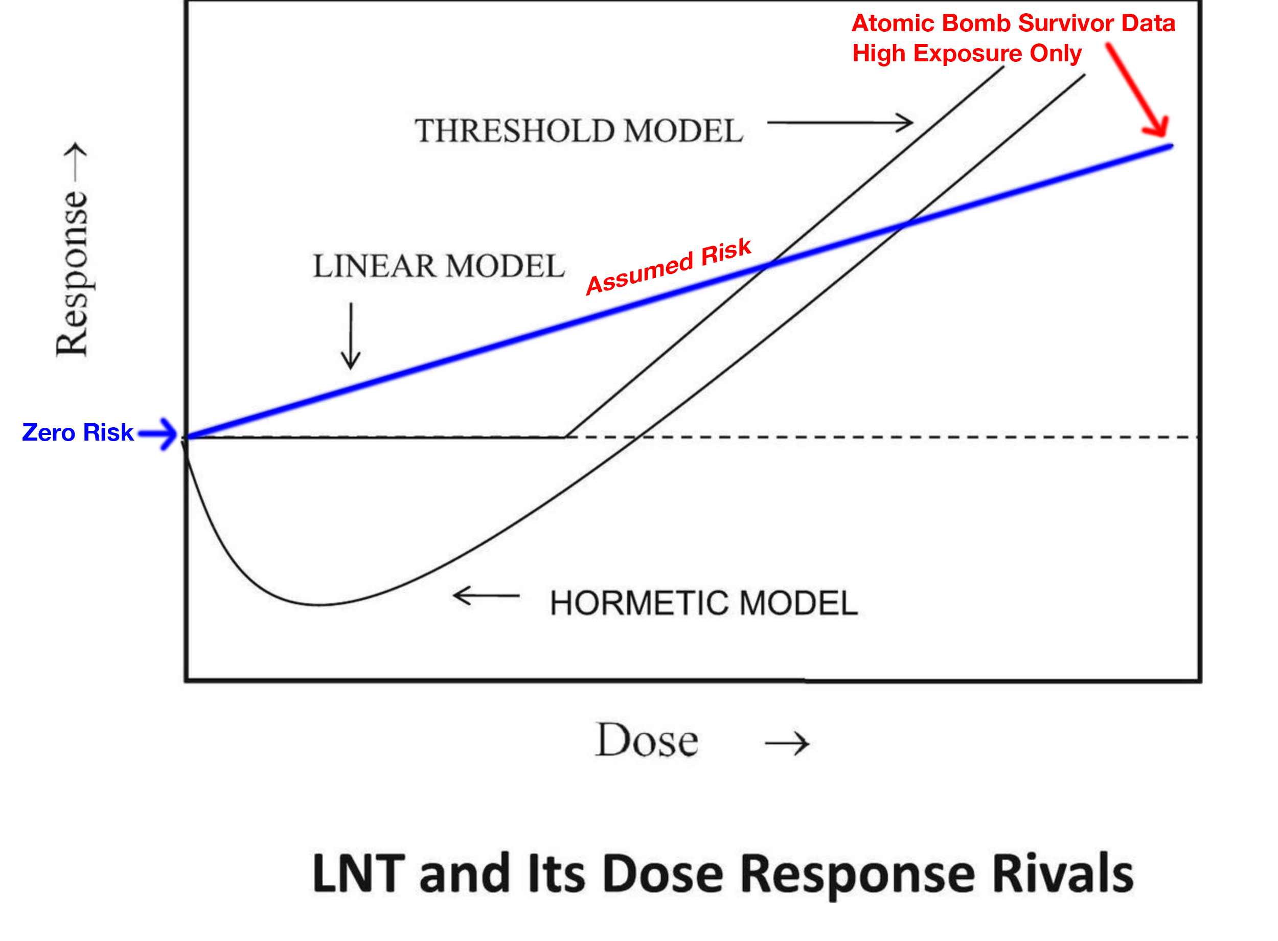
Fix EPA Science – Science Policy + Fraud

Slide 6
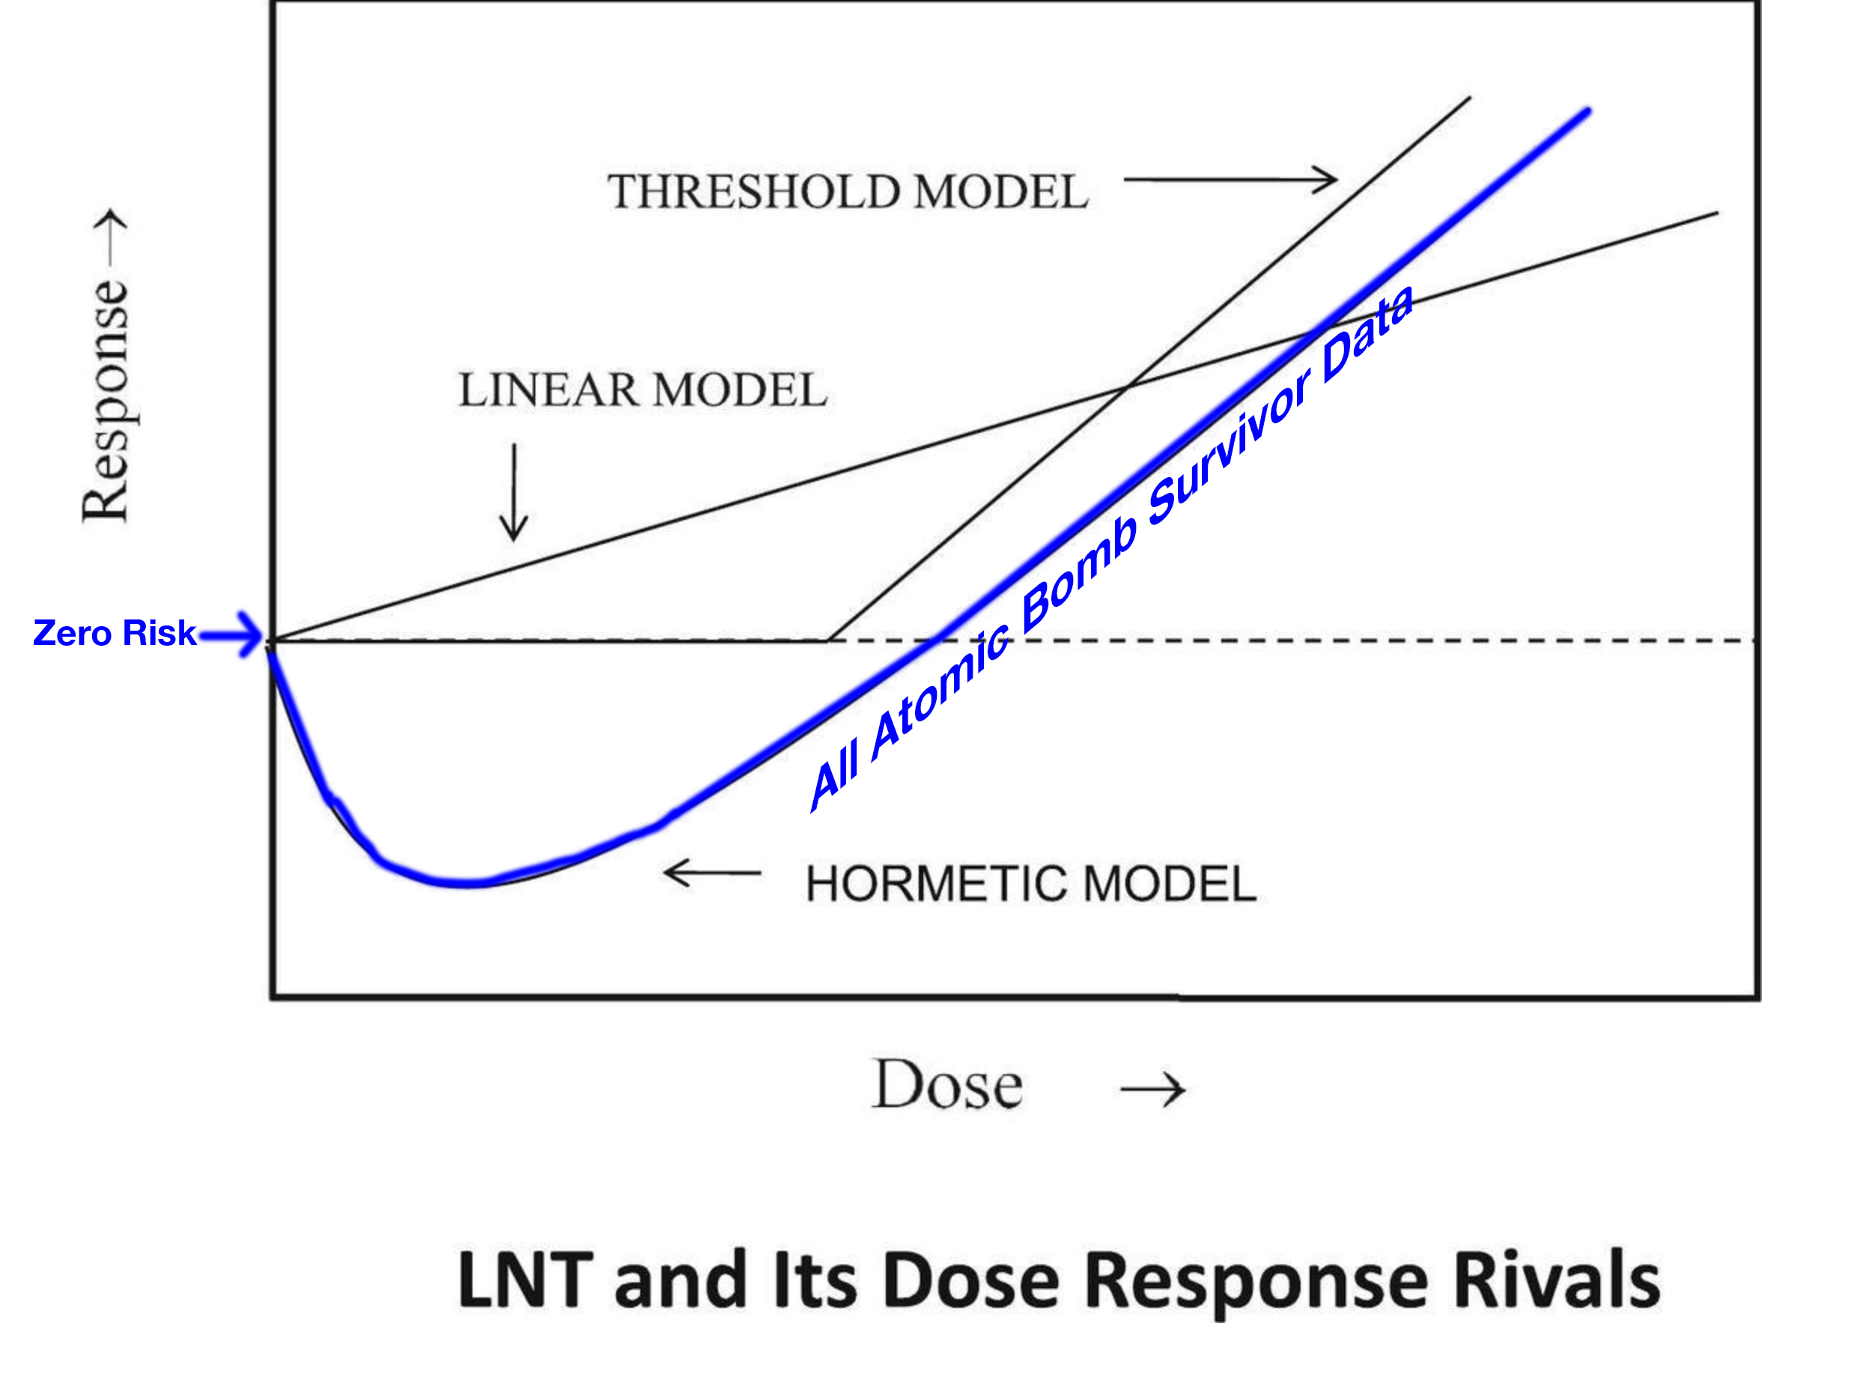
Data-based Risk Model

Slide 7
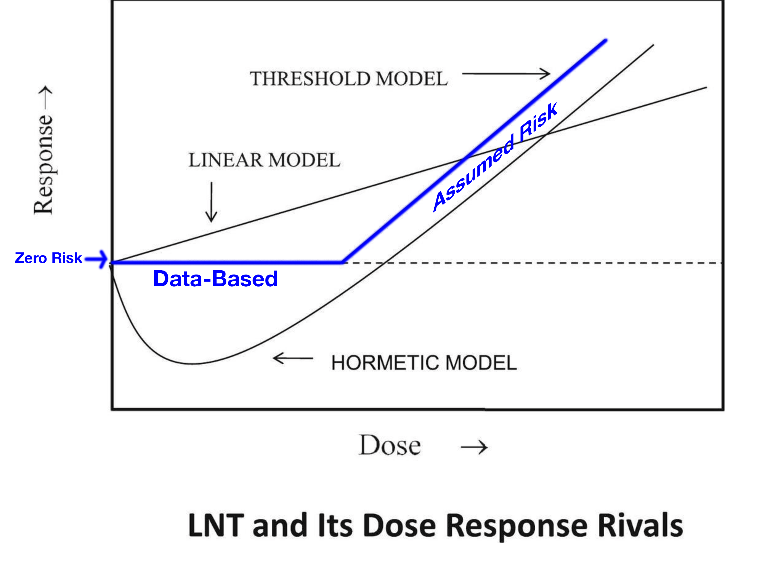
Compromise – Threshold Risk Model

Slide 8
3. Lose MAHA
No need for government food nannying
No need for junk science-fueled food nannying
MAHA scares:
  Processed foods, food additives, pesticides, microplastics, PFAS (“forever chemicals”)
  Will destroy our food system – affordability & availability
MAHA is a left-wing op
  RFK Jr. once advocated jailing energy CEOs & punishing climate skeptics
  ‘Three hots and a cot in the Hague with other war criminals.’
  Tried to get EPA administrator Zeldin fired and are now supporting Democrats

Slide 9
