Slide 1
The Electricity Crisis: Big Tech, Big Utilities & Climate
By Steve Milloy
16th International Conference on Climate Change
Panel: Big Tech and Big Utilities – The Dastardly Axis
April 9, 2026

Slide 2
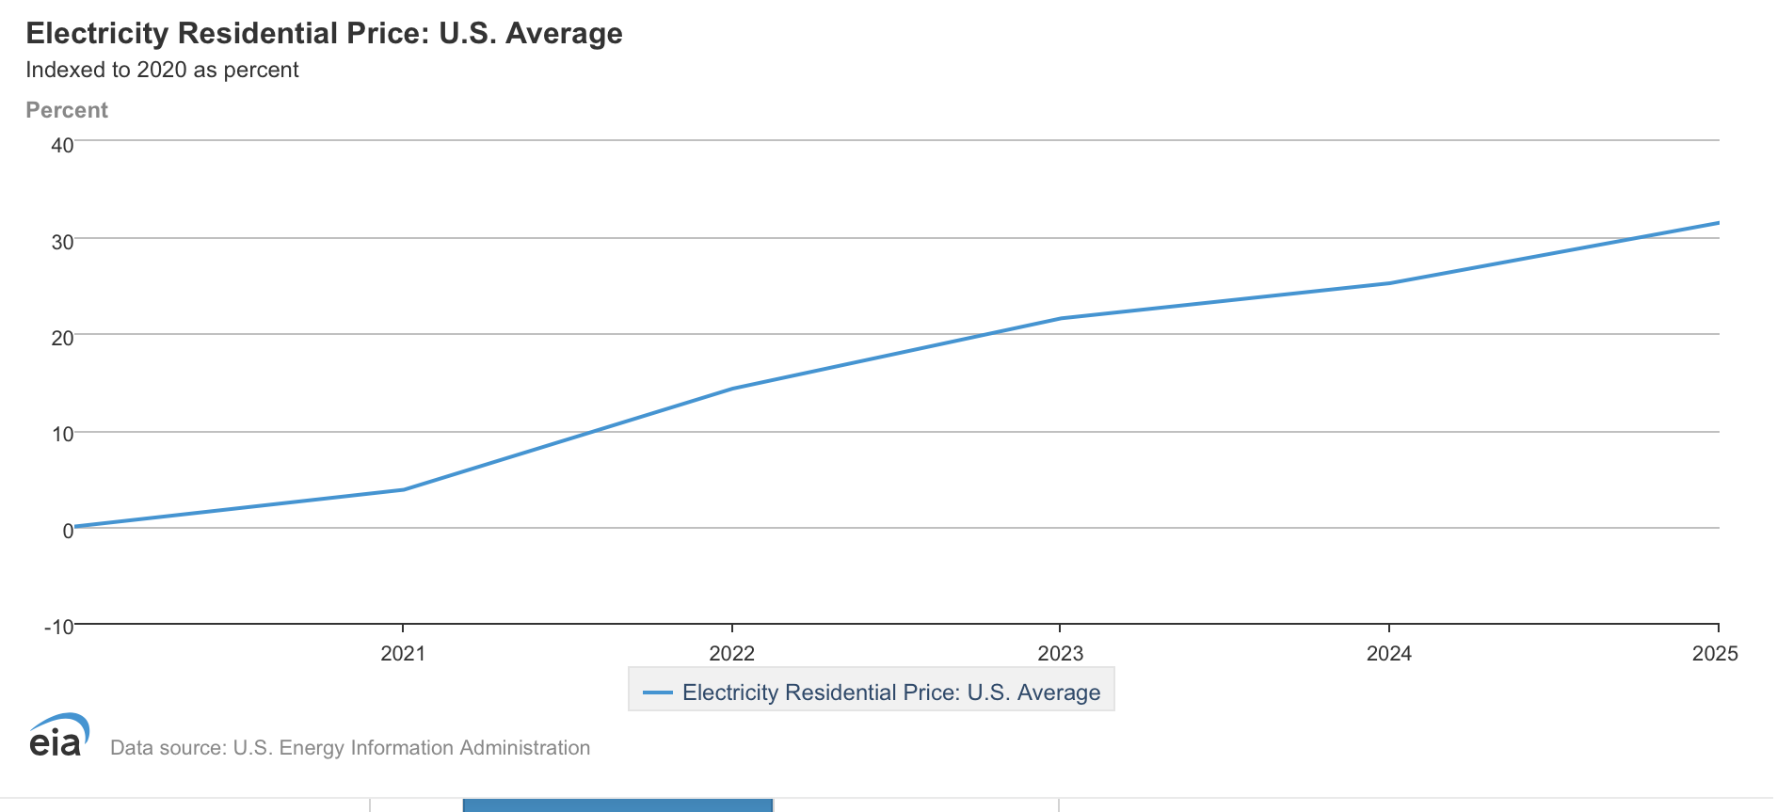
Problem No. 1: Electricity prices are rising

Slide 3
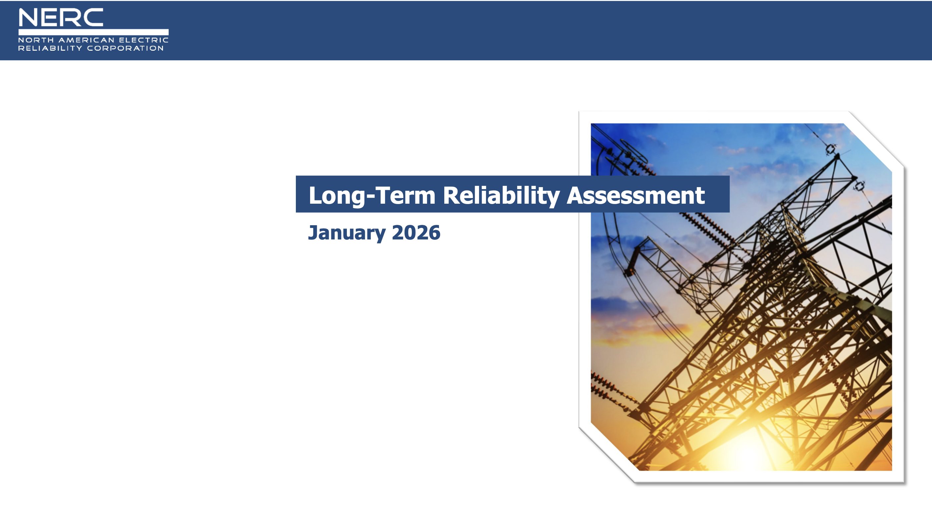
Problem No. 2: Reliability is decreasing ‘The overall resource adequacy outlook for the North American BPS is worsening.’

Slide 4
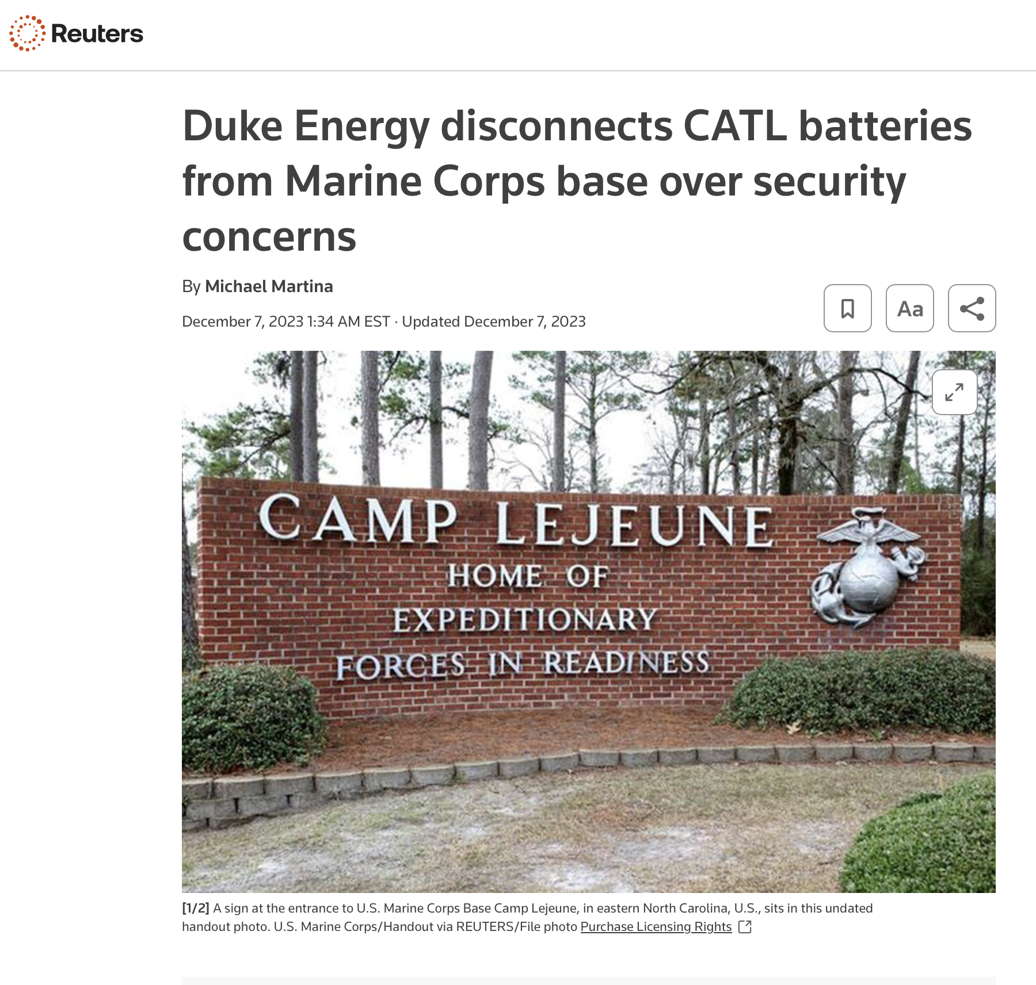
Problem No. 3: Dependence on the Enemy
Solar PV and inverters: 80-90% from China
Battery Storage Systems: 50% from China
Transformers: 80% from China
Rare earths: 90% from China

Slide 5
Problem No. 4: No Accountability for Mismanagement
Old World (until the 1990s)
States regulated local utilities & power grids
Accountability from local politicians and public service commissions
Price and reliability
New World (2000s):
Unaccountable regional grid operators run things
Politicized public service commissions
Complexity few understand
Goal is to be ‘green’

Slide 6
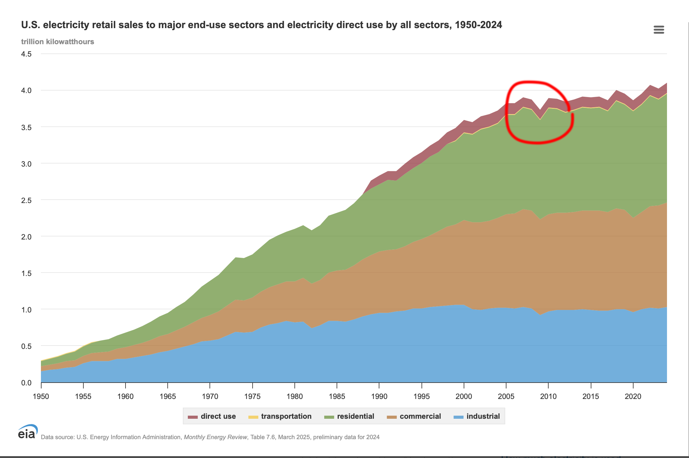
Origin of the Crisis: 2008-2009 Recession

Slide 7
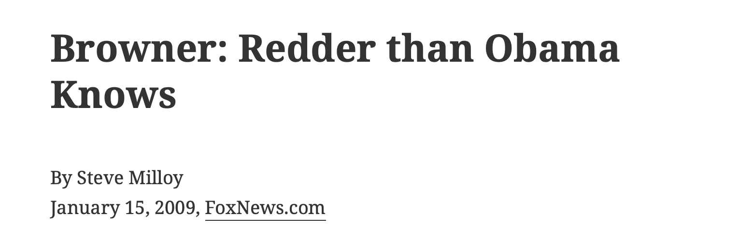
Obama Policy: Electricity Price Decoupling

Slide 8
Decoupling Profits from Volume
Old utility profit model: More electricity at lower prices
New model: Less electricity at higher prices
At the expense of ratepayers and taxpayers
Needed to keep utilities onboard with climate
Profit from new generation (wind, solar, new gas)
Adopted by 35 states by 2019
Strategy abetted by slow growth, degrowth & deindustrialization, globalization

Slide 9
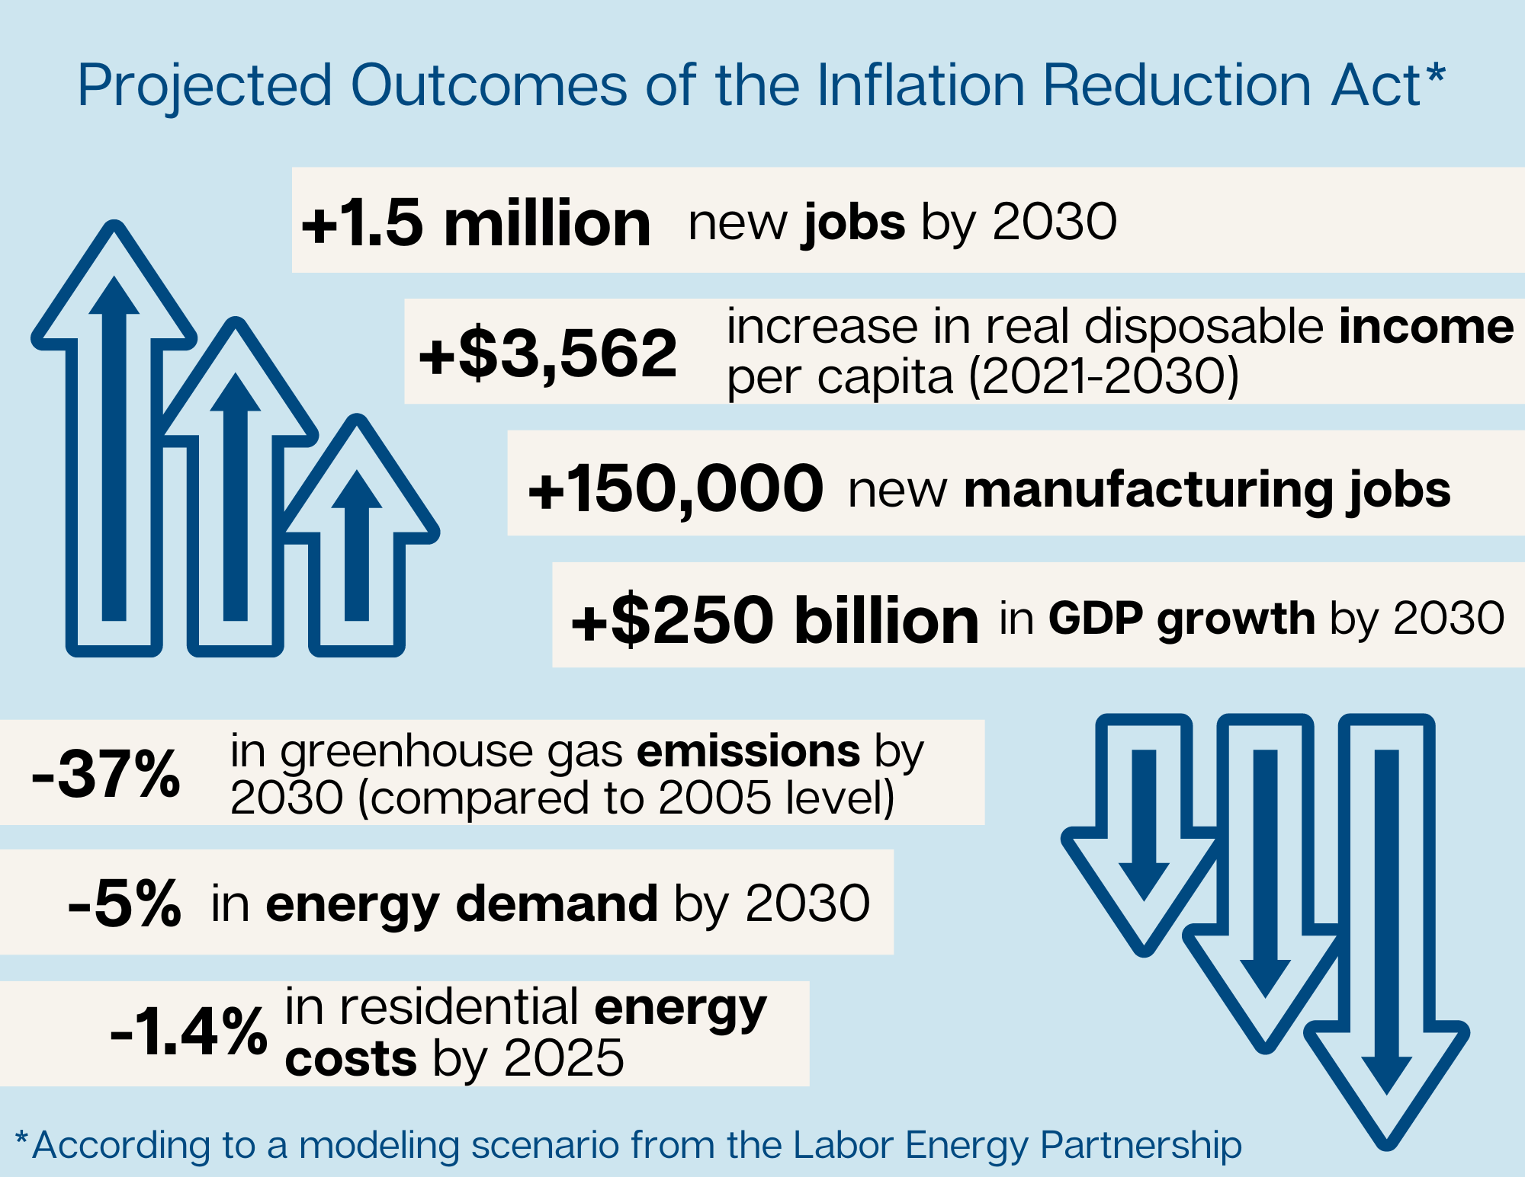
2022: Green New Scam $1.2 Trillion Earmarked for Disaster

Slide 10
Big Tech on Climate: Virtue-Signaling, Leftism, Rentseeking
Apple: Al Gore & Lisa Jackson
Amazon: Bezos gives $10 billion to climate idiocy
Google: ‘Carbon neutrality by 2007’
Microsoft: Bill Gates, ‘Carbon negative by 2030’
Tesla: Musk and government subsidies for EVs
No second opinions needed or requested.
Instead: Censorship, Demonetization & Cancellation

Slide 11
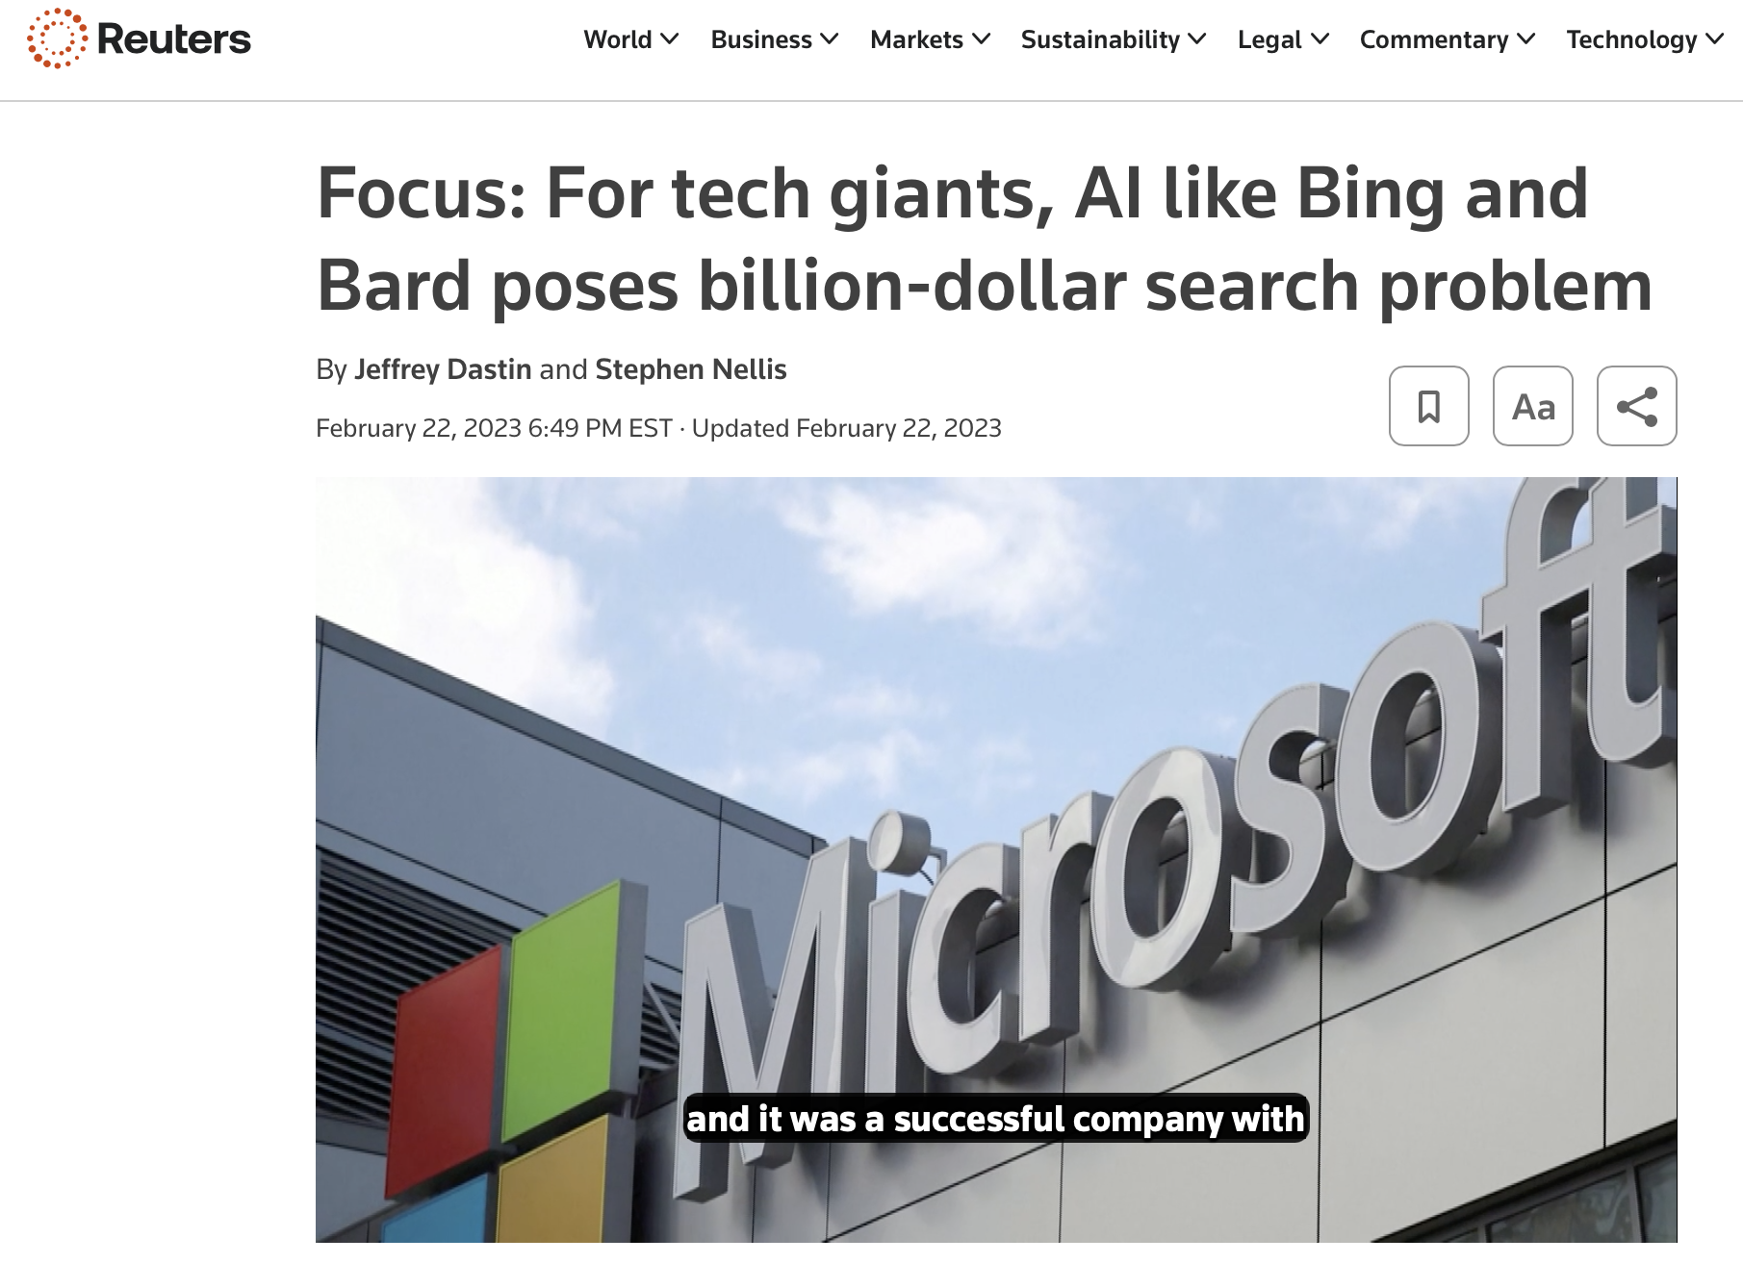
And Then Along Comes AI

Slide 12
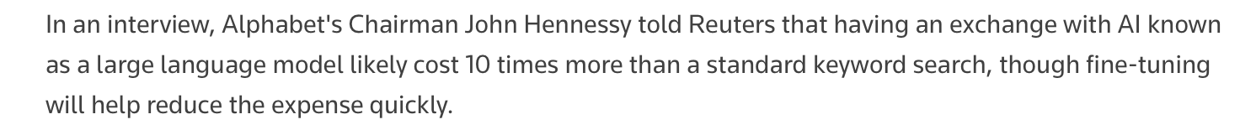
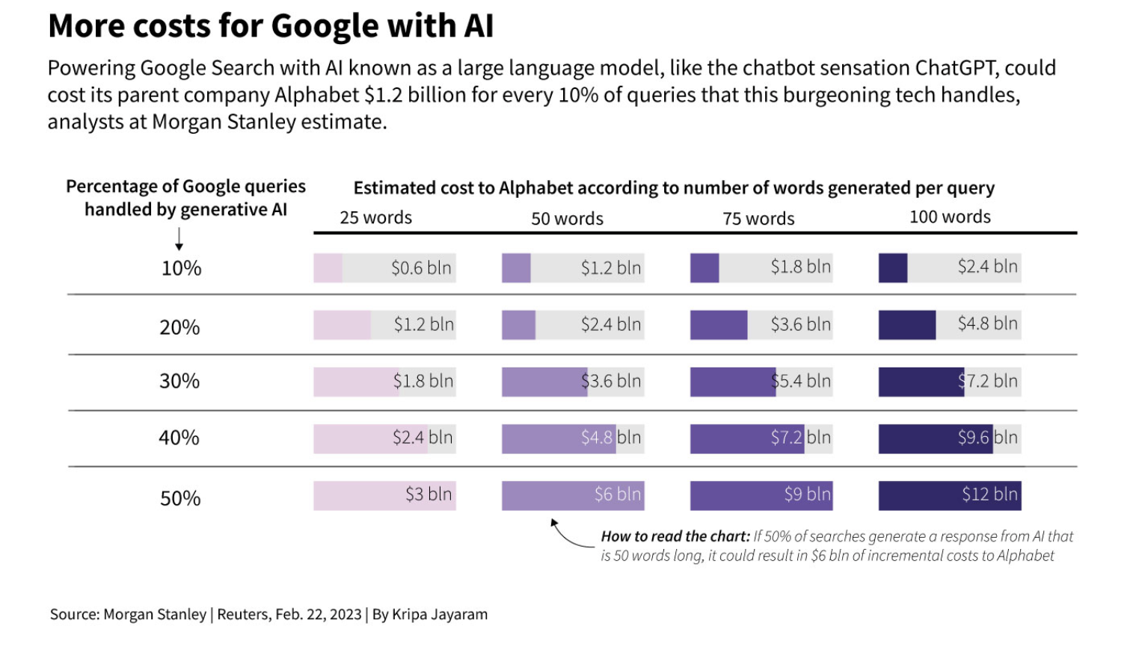
AI costs 10x more than a Google search

Slide 13
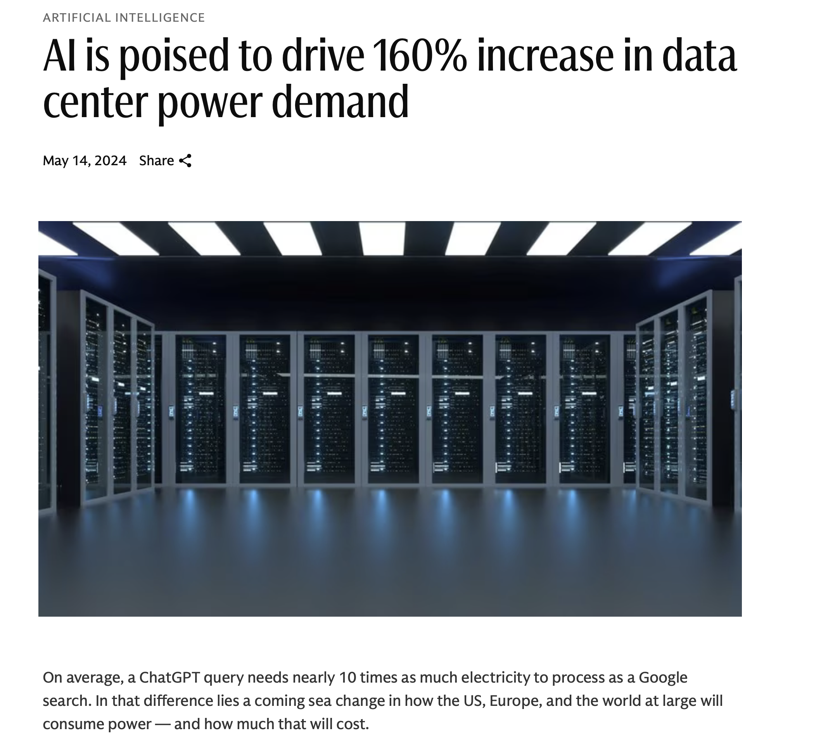
AI more than doubles power demand

Slide 14
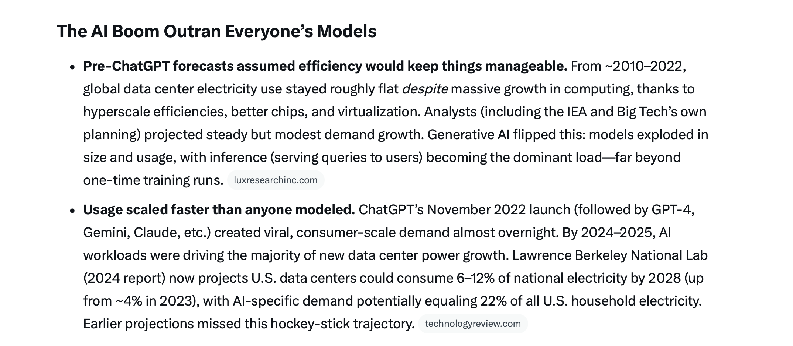
AI Rollout Like Climate: The Folly of Assumptions & Models

Slide 15
The Future
Utilities: Return to selling more power for lower prices
Big Tech: Stick to coding; Abandon public policy it knows noting about (environment & climate)
Government: Return control and accountability for electricity generation and transmission to states

Slide 16
