Slide 1
The Oscar for Being Wrong, Unrepentant, Malignant Category: The Case Against Paul R. Ehrlich, RIP
By Steve Milloy
16th International Conference on Climate Change
Panel: Wrong Again – Embarrassing Record of Failed Climate Predictions
April 8, 2026

Slide 2

The Population Bomb by “Dr. Paul R. Ehrlich”

Slide 3
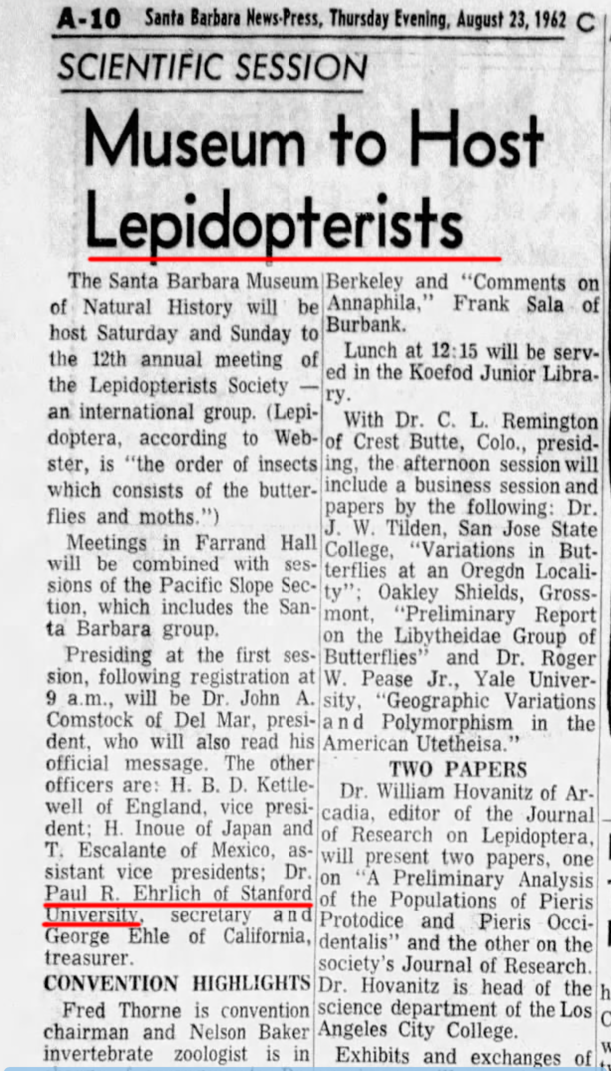

But a Doctor of What?

Slide 4
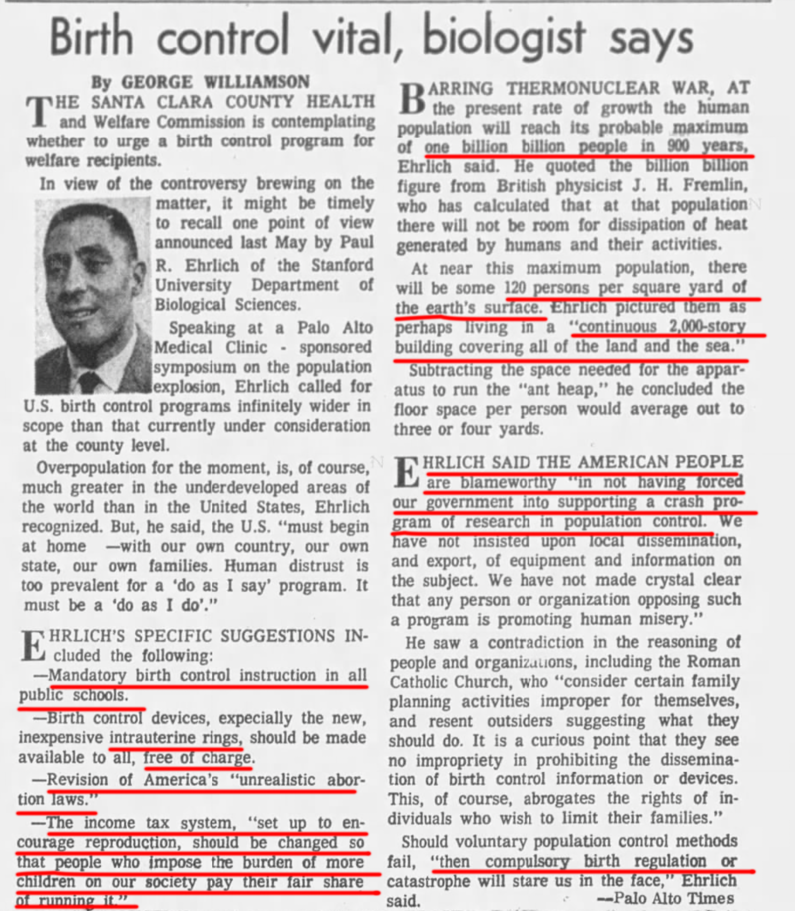
1965 Prediction: ‘One Billion Billion People’
In 900 years
120 persons per square foot
Living in a 2,000 story building covering all of the land surface
America people are ‘blameworthy’ for not demanding:
Mandatory birth control
Free IUDs & abortion
Tax system to discourage people

Slide 5
1967: The Population Bomb
“In the 1970’s, the world will undergo famines hundreds of millions of people are going to starve to death.”
“Depleting the world oxygen supply by paving terrestrial areas, burning fossil fuels and clearing tropical forests.”
Catastrophic global warming would raise sea level 250 feet.
Add chemicals to drinking water for birth control – “the option isn’t even open to us, thanks to the criminal inadequacy of biomedical research in this area.”
Population best at 1-2 billion, but might ”have a chance” at 4 or 5 billion.

Slide 6
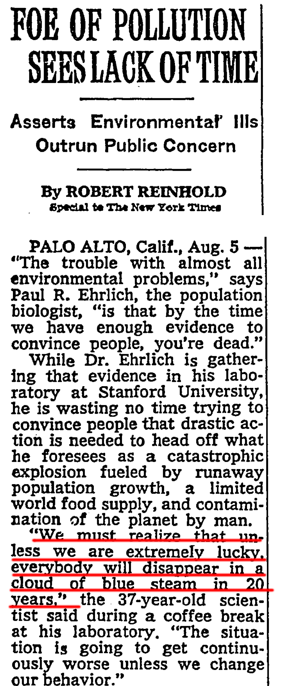
1969: Everybody to disappear by 1989 ‘In a blue cloud of steam’

Slide 7
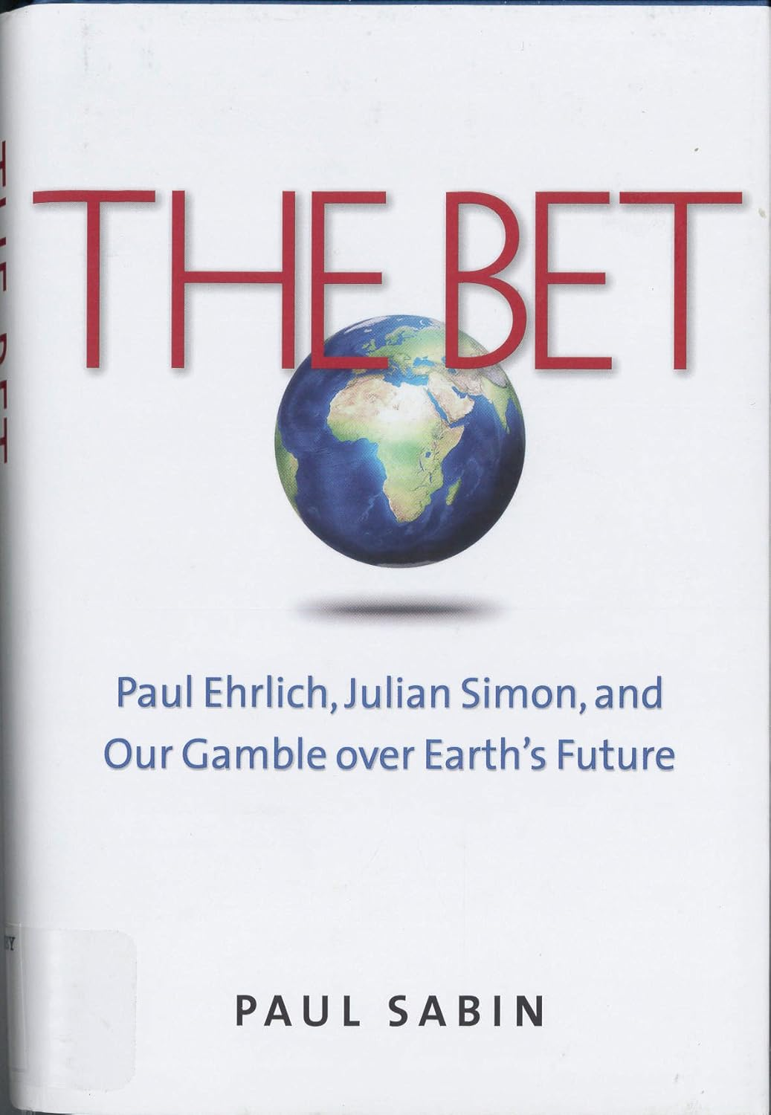
1980: The Bet
Ehrlich bet economist Julian Simon $1,000
Bet: Inflation-adjusted prices of five commodity metals would go up between 1980 and 1990
Result: All five decline in inflation adjusted terms 36-50%
Ehrlich mailed Sinon a check in October 1990

Slide 8
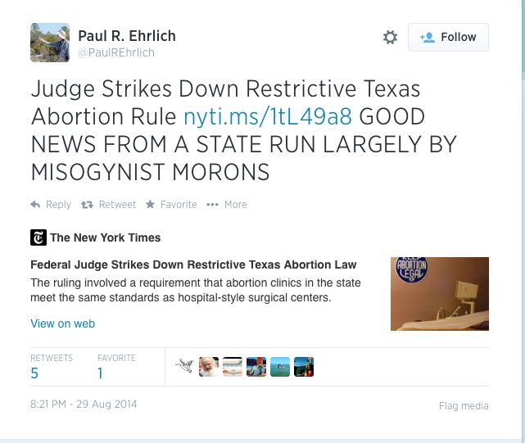

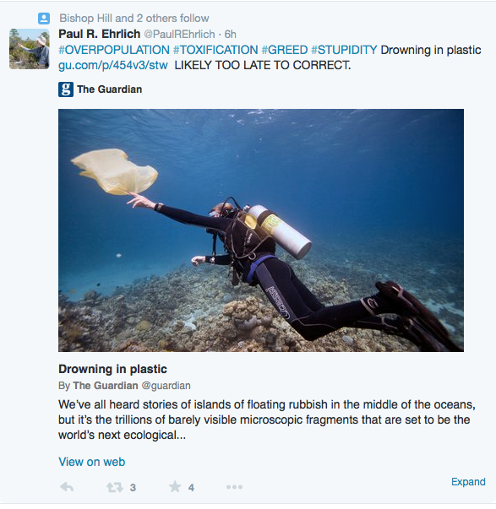
Ehrlich on Social Media Unrepentant Error and Malignancy

Slide 9

2023: 60 Minutes Interview
“Humanity is not sustainable. To maintain our lifestyle (yours and mine, basically) for the entire planet, you’d need five more Earths.”

Slide 10
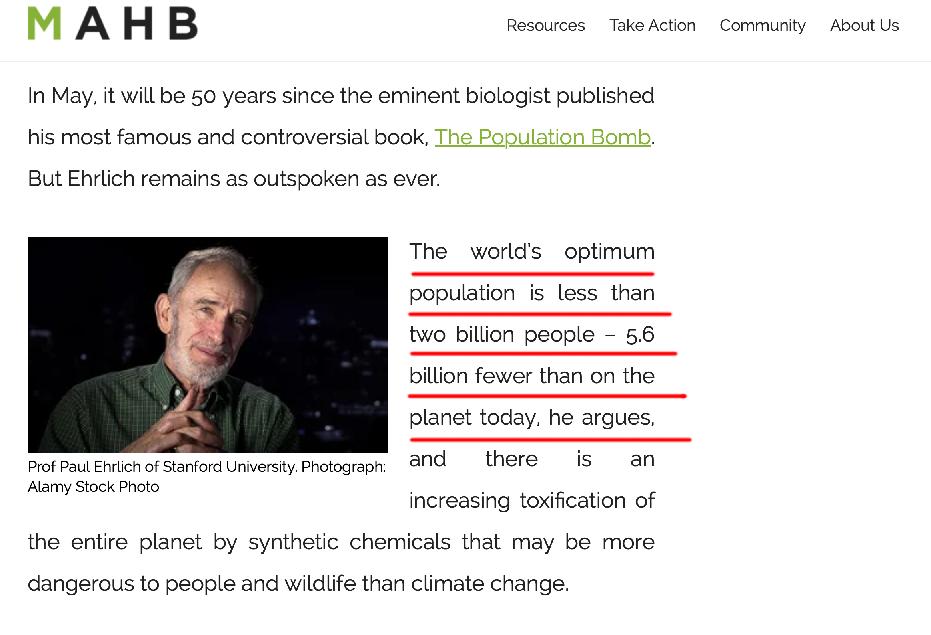
Wrong to the End But Honored All the Way
Professor at Stanford
Member, National Academy of Sciences
MacArthur ‘Genius’ grant
Fellow, Royal Society & AAAS
Other awards/honors to numerous to list

Slide 11
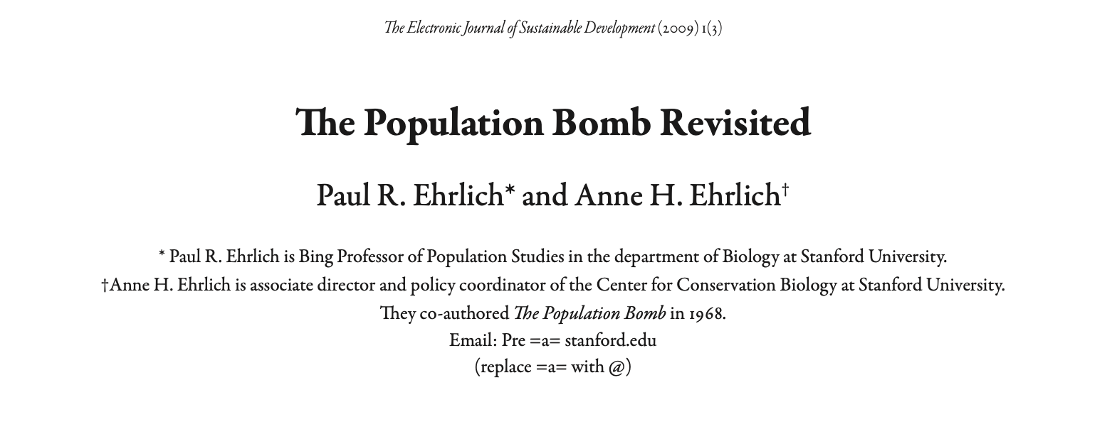
Why was Ehrlich always wrong?

Slide 12
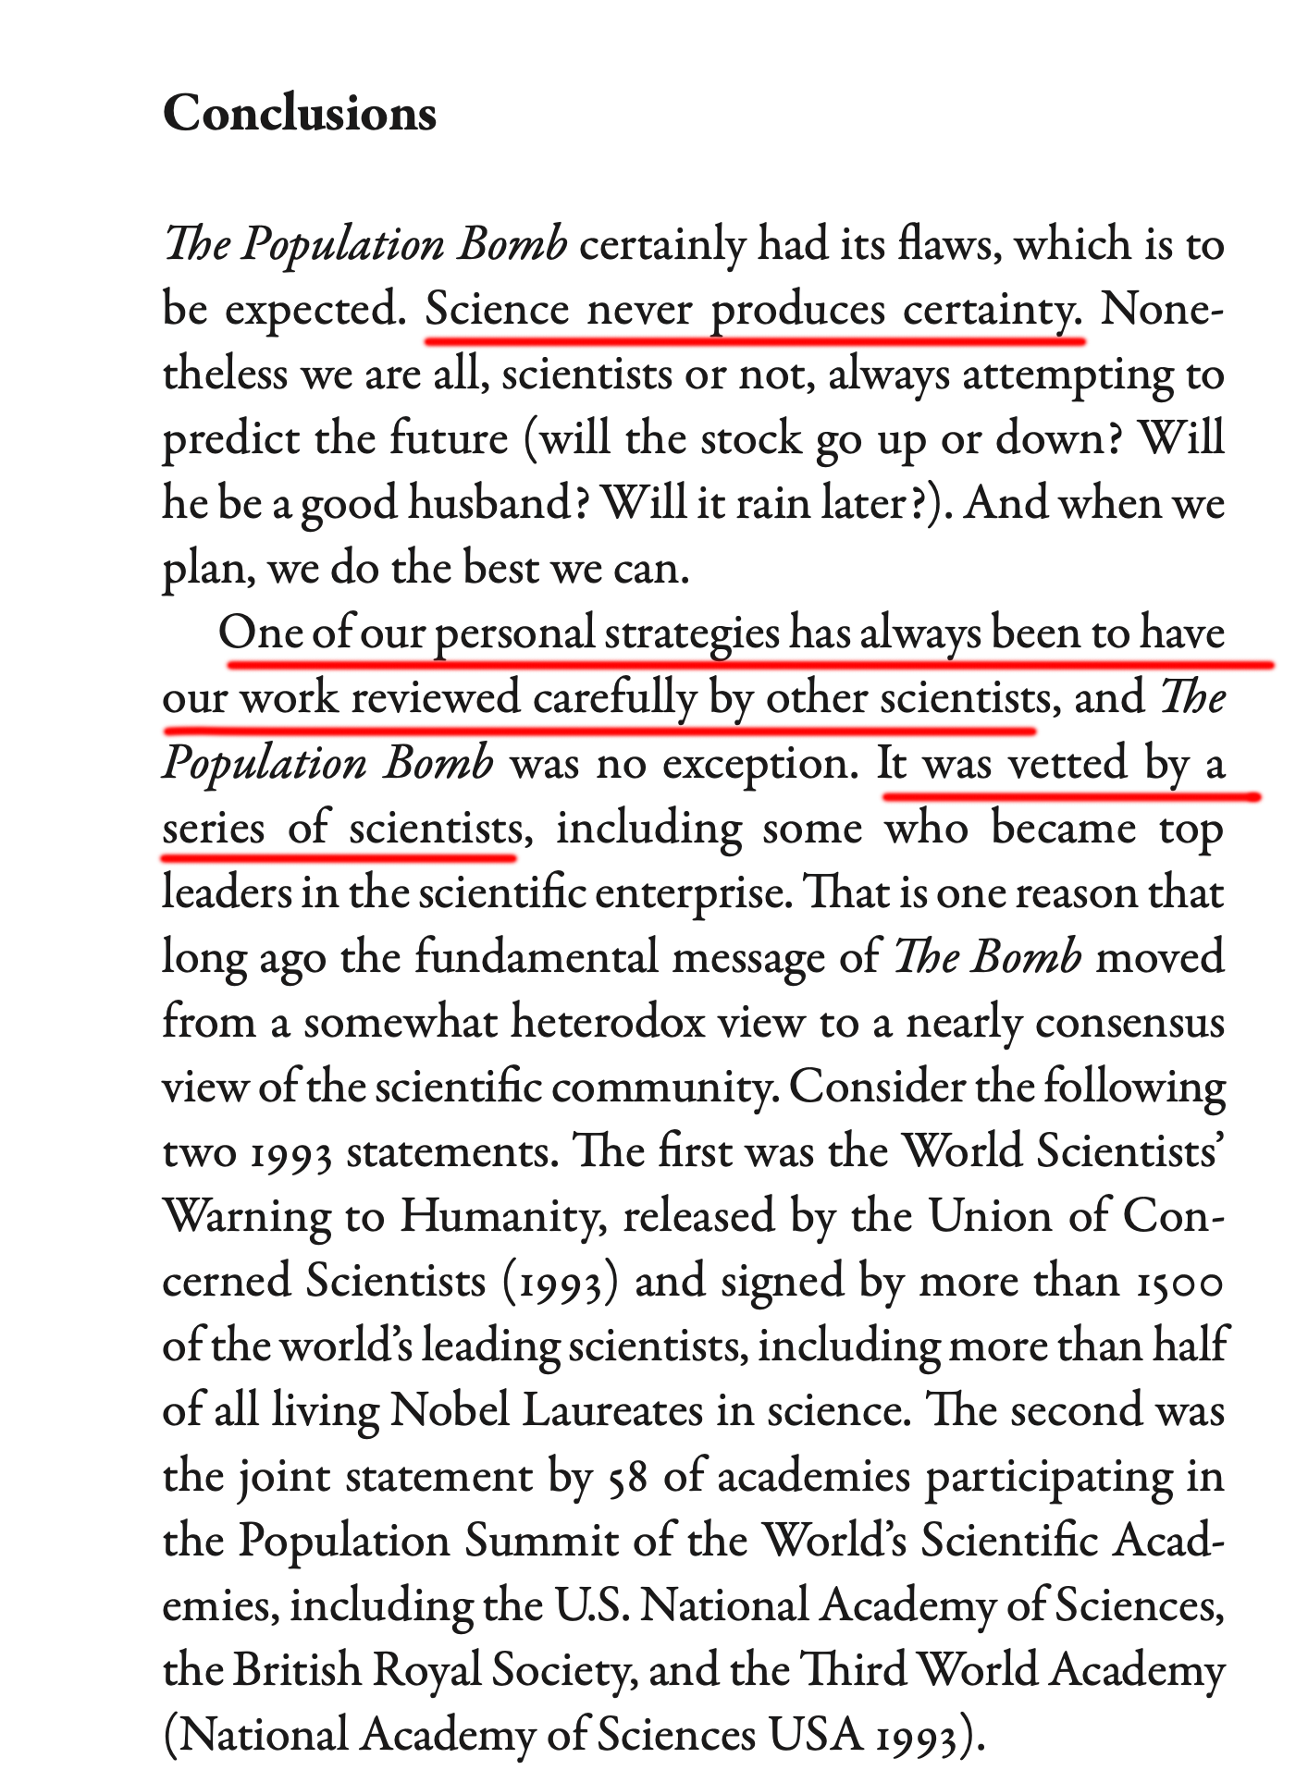
Ehrlich never understood science and blamed others for his errors.
‘Science never produces certainty’.
It was vetted by a series of scientists.
‘Nearly a consensus of the scientific community.’

Slide 13
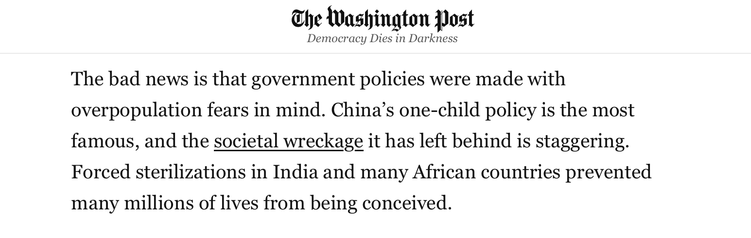
Paul Ehrlich: The most malignantly unrepentant wrong person ever – 61 years.

Slide 14
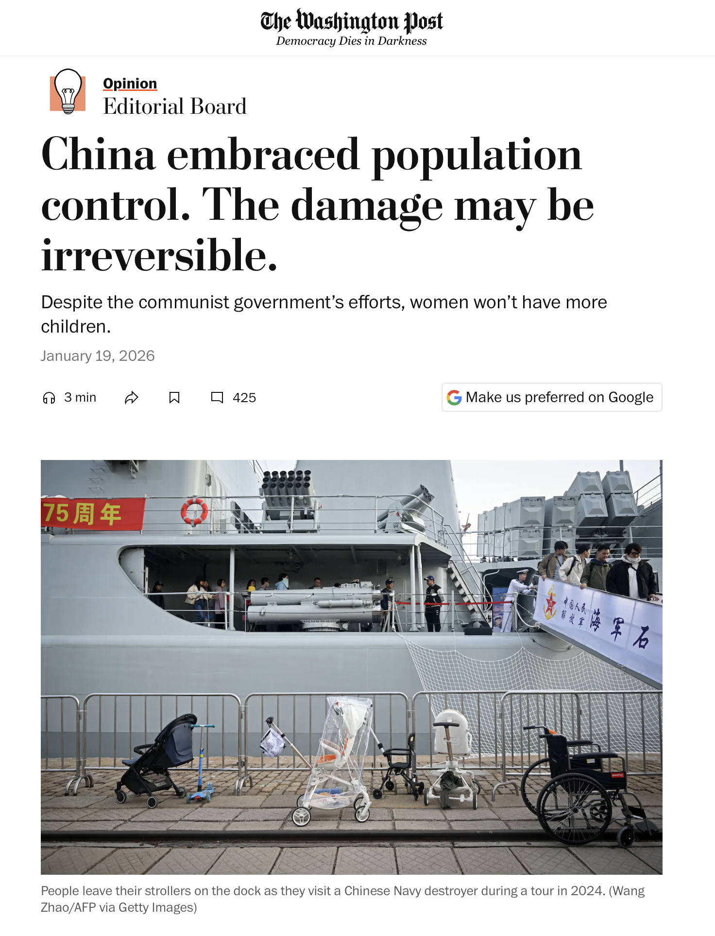
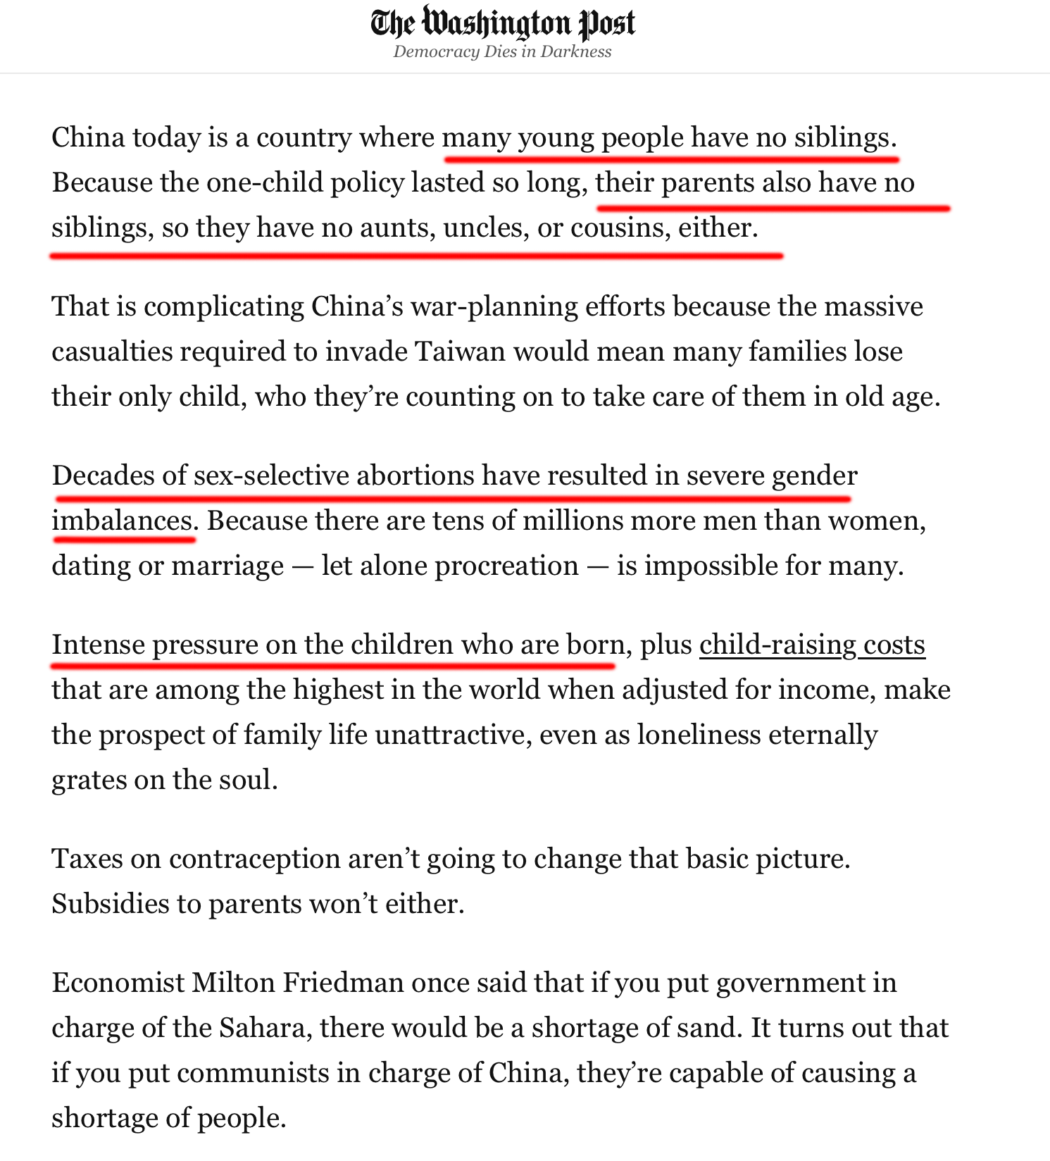
Ehrlich: “China’s population control program has been the most successful on record.”

Slide 15

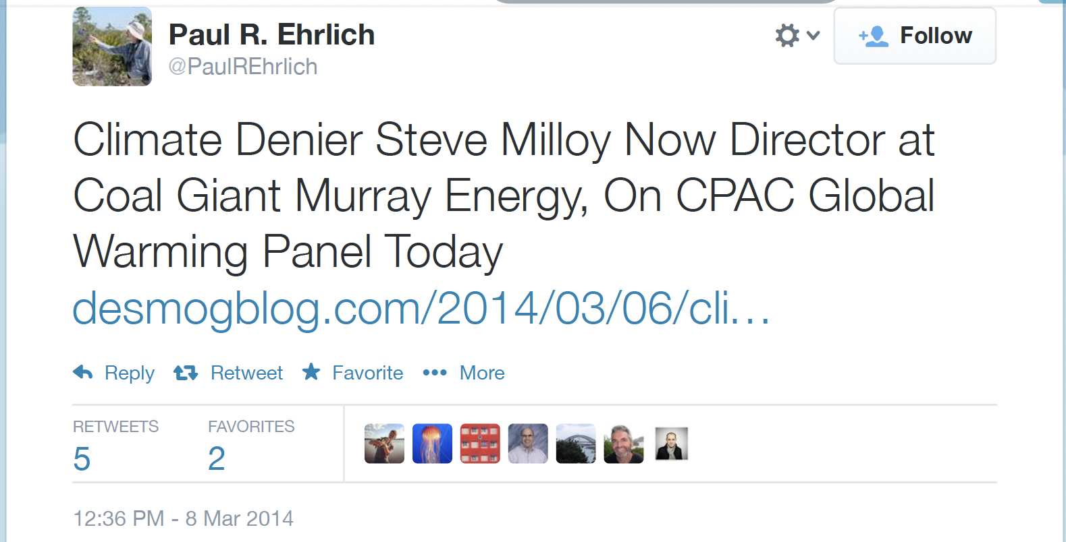
Am I just being mean?

Slide 16


